Slide 1
Modeling, Control, and scheduling of Single-arm Cluster Tools for Concurrently Processing Multiple Wafer Types via Petri Nets
Y. J. Lu, Y. Qiao, C. R. Pan, Y. F. Chen, N. Q. Wu, Z. W. Li, and B. Liu, “Modeling and Control for Deadlock-free Operation of Single-arm Cluster Tools with Concurrently Processing Multiple Wafer Types via Petri Net,” IEEE Access, vol. 9, pp. 70868-70883, 2021.

Slide 2
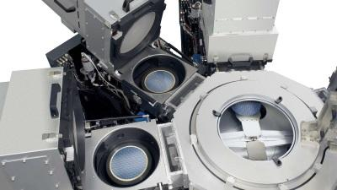
Configuration of a Cluster Tool
1
A cluster tool

Slide 3
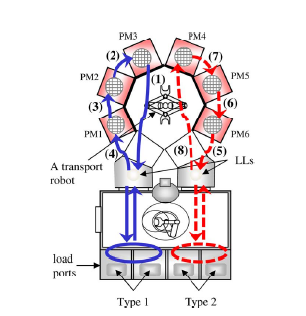
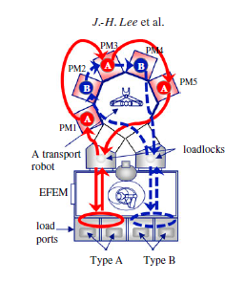
Wafer Processing Routes
2
Shared PMs in the same direction
WFP₁=(PM₁, PM₂, PM₃）
WFP₂=(PM₁, PM₃, PM₄)
WFP₃=(PM₂, PM₄, PM₅)
Shared PMs in the opposite direction
WFP₁=(PM₁, PM₂, PM₃)
No shared PM
Shared one PM
WFP₂=(PM₄, PM₂, PM₁)
Two wafer types
WFP₃=(PM₂, PM₃, PM₆)

Slide 4
Deadlock Cases
3
Example 1: In the example, both PM₁,and PM₂ have a wafer being processed, while PM₃,and PM₄ are empty.

Slide 5
Problem Description
4
Modeling and control for deadlock-free operation a single-arm cluster tools
Single-arm cluster tools
Multiple wafer types
Sequential wafer routes
System deadlocks
The processing routes of two wafer types in an SACT

Slide 6
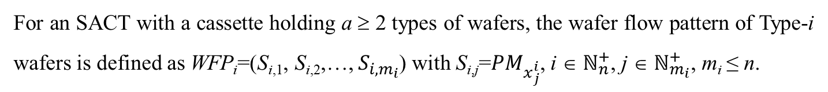


Wafer Flow Pattern
5
For an SACT with a cassette holding a ≥ 2 types of wafers, the wafer flow pattern of Type-i wafers is defined as WFP_{i}=(S_{i,1}, S_{i,2},…, $S_{{i,m}_{i}}$) with S_{i,j}=${PM}_{x_{j}^{i}}$, i ∈ $ℕ_{n}^{+}$, j ∈ $ℕ_{m_{i}}^{+}$, m_{i} ≤ n.
Example 2:
WFP₁=(S_{1,1}, S_{1,2}, S_{1,3})${\text{,} x}_{1}^{1}$=1,${ x}_{2}^{1}$ =2, $x_{3}^{1}$ = 3
WFP₂=(S_{2,1}, S_{2,2}, S_{2,3})${\text{,} x}_{1}^{2}$=1, $x_{2}^{2}$ =3, $x_{3}^{2}$ = 4
WFP₁=(PM₁, PM₂, PM₃)
WFP₂=(PM₁, PM₃, PM₄)

Slide 7
Petri net modeling
6
The part of Petri net model related to the loadlock accessing

Slide 8
Petri net modeling
6
The part of Petri net model related to the loadlock accessing

Slide 9
Petri net modeling
6
The Petri net modeling related to Step j and Type i wafers

Slide 10
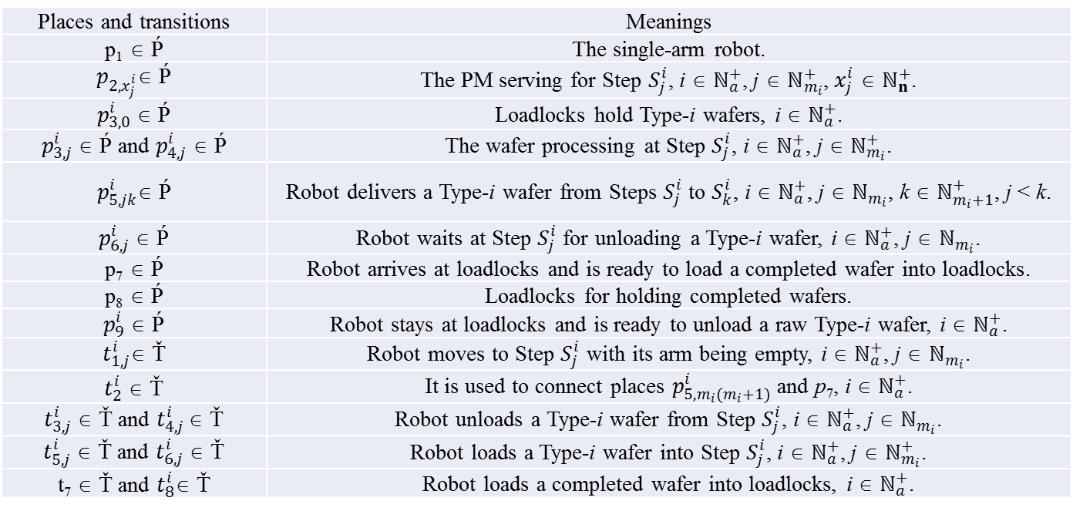
Petri net modeling
6
Table 2.1 The meanings of places and transitions
Places and transitions | Meanings
p₁ ∈ Ṕ | The single-arm robot.
$p_{2,x_{j}^{i}}$∈ Ṕ | The PM serving for Step $S_{j}^{i}$, i ∈ $ℕ_{a}^{+}$, j ∈ $ℕ_{m_{i}}^{+}$, $x_{j}^{i}$ ∈ $ℕ_{n}^{+}$.
$p_{3,0}^{i}$ ∈ Ṕ | Loadlocks hold Type-i wafers, i ∈ $ℕ_{a}^{+}$.
$p_{3,j}^{i}$ ∈ Ṕ and $p_{4,j}^{i}$ ∈ Ṕ | The wafer processing at Step $S_{j}^{i}$, i ∈ $ℕ_{a}^{+}$, j ∈ $ℕ_{m_{i}}^{+}$.
$p_{5,jk}^{i}$∈ Ṕ | Robot delivers a Type-i wafer from Steps $S_{j}^{i}$ to $S_{k}^{i}$, i ∈ $ℕ_{a}^{+}$, j ∈ $ℕ_{m_{i}}$, k ∈ $ℕ_{m_{i}+1}^{+}$, j < k.
$p_{6,j}^{i}$ ∈ Ṕ | Robot waits at Step $S_{j}^{i}$ for unloading a Type-i wafer, i ∈ $ℕ_{a}^{+}$, j ∈ $ℕ_{m_{i}}$.
p₇ ∈ Ṕ | Robot arrives at loadlocks and is ready to load a completed wafer into loadlocks.
p₈ ∈ Ṕ | Loadlocks for holding completed wafers.
$p_{9}^{i}$ ∈ Ṕ | Robot stays at loadlocks and is ready to unload a raw Type-i wafer, i ∈ $ℕ_{a}^{+}$.
$t_{1,j}^{i}$∈ Ť | Robot moves to Step $S_{j}^{i}$ with its arm being empty, i ∈ $ℕ_{a}^{+}$, j ∈ $ℕ_{m_{i}}$.
$t_{2}^{i}$ ∈ Ť | It is used to connect places $p_{5,m_{i}(m_{i}+1)}^{i}$ and p₇, i ∈ $ℕ_{a}^{+}$.
$t_{3,j}^{i}$ ∈ Ť and $t_{4,j}^{i}$ ∈ Ť | Robot unloads a Type-i wafer from Step $S_{j}^{i}$, i ∈ $ℕ_{a}^{+}$, j ∈ $ℕ_{m_{i}}$.
$t_{5,j}^{i}$ ∈ Ť and $t_{6,j}^{i}$ ∈ Ť | Robot loads a Type-i wafer into Step $S_{j}^{i}$, i ∈ $ℕ_{a}^{+}$, j ∈ $ℕ_{m_{i}}^{+}$.
t₇ ∈ Ť and $t_{8}^{i}$∈ Ť | Robot loads a completed wafer into loadlocks, i ∈ $ℕ_{a}^{+}$.

Slide 11
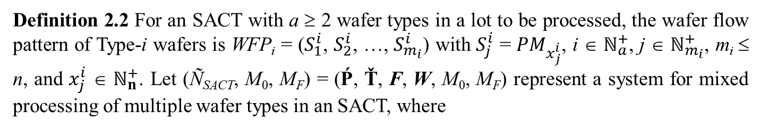
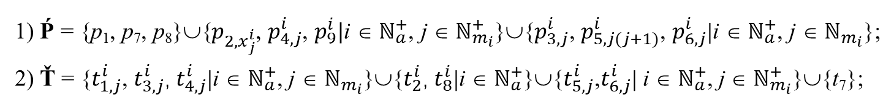
Petri net modeling
6
Definition 2.2 For an SACT with a ≥ 2 wafer types in a lot to be processed, the wafer flow pattern of Type-i wafers is WFP_{i} = ($S_{1}^{i}$, $S_{2}^{i}$, …, $S_{m_{i}}^{i}$) with $S_{j}^{i}$ = ${PM}_{x_{j}^{i}}$, i ∈ $ℕ_{a}^{+}$, j ∈ $ℕ_{m_{i}}^{+}$, m_{i} ≤ n, and $x_{j}^{i}$ ∈ $ℕ_{n}^{+}$. Let (Ñ_{SACT}, M₀, M_{F}) = (Ṕ, Ť, F, W, M₀, M_{F}) represent a system for mixed processing of multiple wafer types in an SACT, where
1) Ṕ = {p₁, p₇, p₈}∪{$p_{2,x_{j}^{i}}$, $p_{4,j}^{i}$, $p_{9}^{i}|$i ∈ $ℕ_{a}^{+}$, j ∈ $ℕ_{m_{i}}^{+}$}∪{$p_{3,j}^{i}$, $p_{5,j(j+1)}^{i}$, $p_{6,j}^{i}$|i ∈ $ℕ_{a}^{+}$, j ∈ $ℕ_{m_{i}}$};
2) Ť = {$t_{1,j}^{i}$, $t_{3,j}^{i}$, $t_{4,j}^{i}$|i ∈ $ℕ_{a}^{+}$, j ∈ $ℕ_{m_{i}}$}∪{$t_{2}^{i}$, $t_{8}^{i}$|i ∈ $ℕ_{a}^{+}$}∪{$t_{5,j}^{i}$,$t_{6,j}^{i}$| i ∈ $ℕ_{a}^{+}$, j ∈ $ℕ_{m_{i}}^{+}$}∪{t₇};

Slide 12
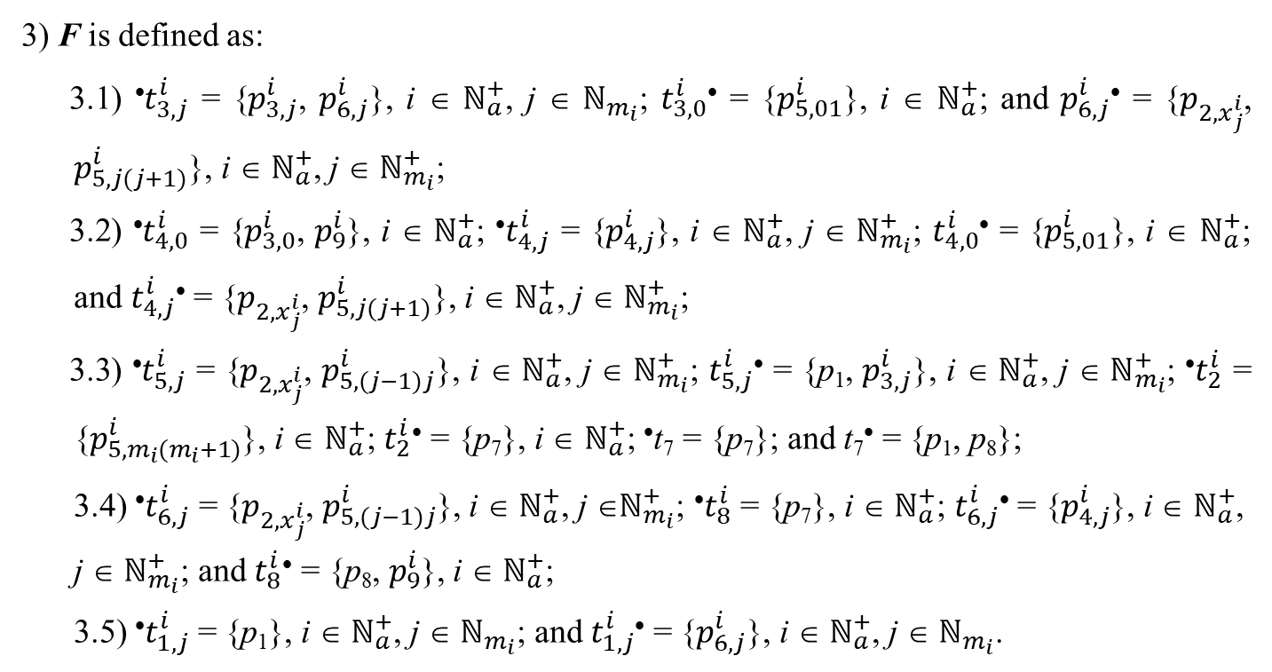
Petri net modeling
6
3) F is defined as:
3.1) •$t_{3,j}^{i}$ = {$p_{3,j}^{i}$, $p_{6,j}^{i}$}, i ∈ $ℕ_{a}^{+}$, j ∈ $ℕ_{m_{i}}$; $t_{3,0}^{i}$• = {$p_{5,01}^{i}$}, i ∈ $ℕ_{a}^{+}$; and $p_{6,j}^{i}$• = {$p_{2,x_{j}^{i}}$, $p_{5,j(j+1)}^{i}$}, i ∈ $ℕ_{a}^{+}$, j ∈ $ℕ_{m_{i}}^{+}$;
3.2) •$t_{4,0}^{i}$ = {$p_{3,0}^{i}$, $p_{9}^{i}$}, i ∈ $ℕ_{a}^{+}$; •$t_{4,j}^{i}$ = {$p_{4,j}^{i}$}, i ∈ $ℕ_{a}^{+}$, j ∈ $ℕ_{m_{i}}^{+}$; $t_{4,0}^{i}$• = {$p_{5,01}^{i}$}, i ∈ $ℕ_{a}^{+}$; and $t_{4,j}^{i}$• = {$p_{2,x_{j}^{i}}$, $p_{5,j(j+1)}^{i}$}, i ∈ $ℕ_{a}^{+}$, j ∈ $ℕ_{m_{i}}^{+}$;
3.3) •$t_{5,j}^{i}$ = {$p_{2,x_{j}^{i}}$, $p_{5,(j−1)j}^{i}$}, i ∈ $ℕ_{a}^{+}$, j ∈ $ℕ_{m_{i}}^{+}$; $t_{5,j}^{i}$• = {p₁, $p_{3,j}^{i}$}, i ∈ $ℕ_{a}^{+}$, j ∈ $ℕ_{m_{i}}^{+}$; •$t_{2}^{i}$ = {$p_{5,m_{i}(m_{i}+1)}^{i}$}, i ∈ $ℕ_{a}^{+}$; $t_{2}^{i}$• = {p₇}, i ∈ $ℕ_{a}^{+}$; •t₇ = {p₇}; and t₇• = {p₁, p₈};
3.4) •$t_{6,j}^{i}$ = {$p_{2,x_{j}^{i}}$, $p_{5,(j−1)j}^{i}$}, i ∈ $ℕ_{a}^{+}$, j ∈$ℕ_{m_{i}}^{+}$; •$t_{8}^{i}$ = {p₇}, i ∈ $ℕ_{a}^{+}$; $t_{6,j}^{i}$• = {$p_{4,j}^{i}$}, i ∈ $ℕ_{a}^{+}$, j ∈ $ℕ_{m_{i}}^{+}$; and $t_{8}^{i}$• = {p₈, $p_{9}^{i}$}, i ∈ $ℕ_{a}^{+}$;
3.5) •$t_{1,j}^{i}$ = {p₁}, i ∈ $ℕ_{a}^{+}$, j ∈ $ℕ_{m_{i}}$; and $t_{1,j}^{i}$• = {$p_{6,j}^{i}$}, i ∈ $ℕ_{a}^{+}$, j ∈ $ℕ_{m_{i}}$.

Slide 13
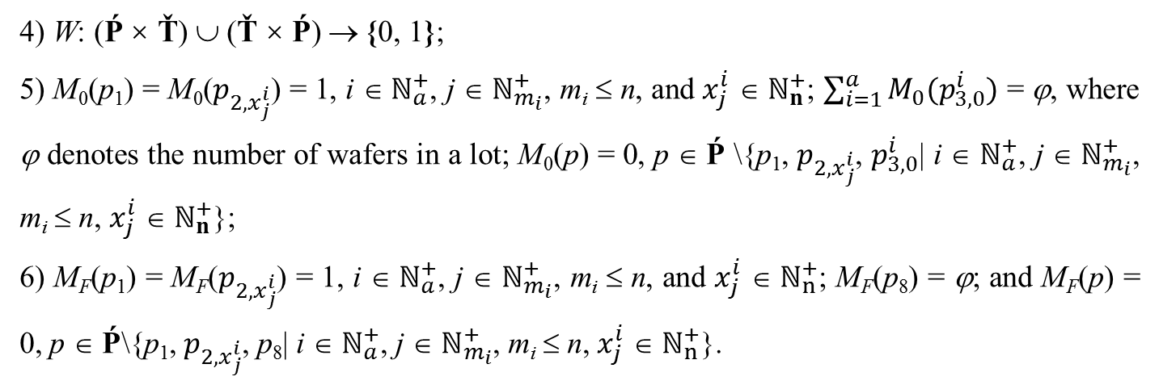
Petri net modeling
6
4) W: (Ṕ × Ť) ∪ (Ť × Ṕ) → {0, 1};
5) M₀(p₁) = M₀($p_{2,x_{j}^{i}}$) = 1, i ∈ $ℕ_{a}^{+}$, j ∈ $ℕ_{m_{i}}^{+}$, m_{i} ≤ n, and $x_{j}^{i}$ ∈ $ℕ_{n}^{+}$; $\sum_{i=1}^{a}{M_{0}(p_{3,0}^{i})}$ = ϕ, where ϕ denotes the number of wafers in a lot; M₀(p) = 0, p ∈ Ṕ \{p₁, $p_{2,x_{j}^{i}}$, $p_{3,0}^{i}$| i ∈ $ℕ_{a}^{+}$, j ∈ $ℕ_{m_{i}}^{+}$, m_{i} ≤ n, $x_{j}^{i}$ ∈ $ℕ_{n}^{+}$};
6) M_{F}(p₁) = M_{F}($p_{2,x_{j}^{i}}$) = 1, i ∈ $ℕ_{a}^{+}$, j ∈ $ℕ_{m_{i}}^{+}$, m_{i} ≤ n, and $x_{j}^{i}$ ∈ $ℕ_{n}^{+}$; M_{F}(p₈) = ϕ; and M_{F}(p) = 0, p ∈ Ṕ\{p₁, $p_{2,x_{j}^{i}}$, p₈| i ∈ $ℕ_{a}^{+}$, j ∈ $ℕ_{m_{i}}^{+}$, m_{i} ≤ n, $x_{j}^{i}$ ∈ $ℕ_{n}^{+}$}.

Slide 14
Petri net modeling
6
loading raw wafers
WFP₁ = (PM₁, PM₂)
WFP₂ = (PM₁, PM₃)
PM
Step 1
robot
Step 2
loading completed wafers

Slide 15
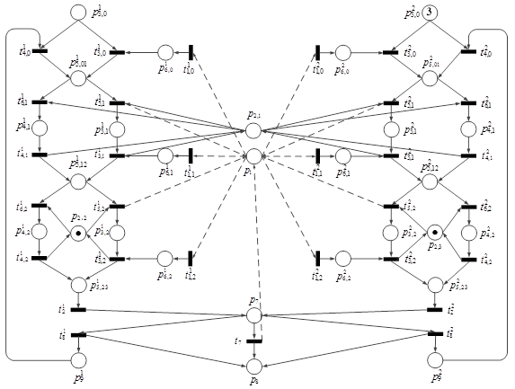
Deadlock analysis
6
check
resources
WFP₁ = (PM₁, PM₂)
WFP₂ = (PM₁, PM₃)

Slide 16
Deadlock analysis
6
WFP₁ = (PM₁, PM₂)
WFP₂ = (PM₁, PM₃)

Slide 17
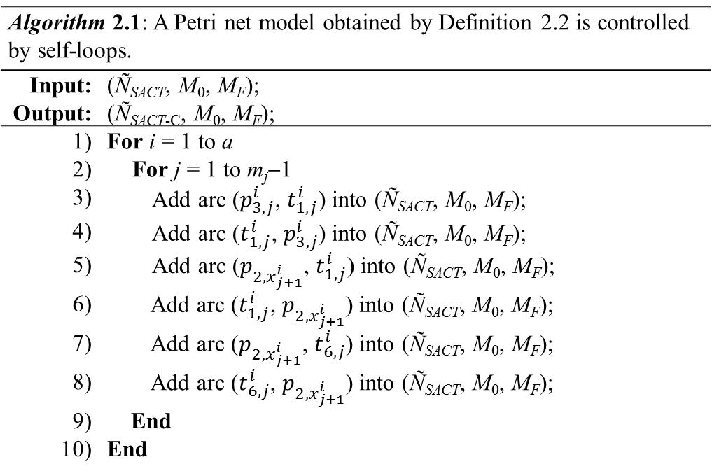
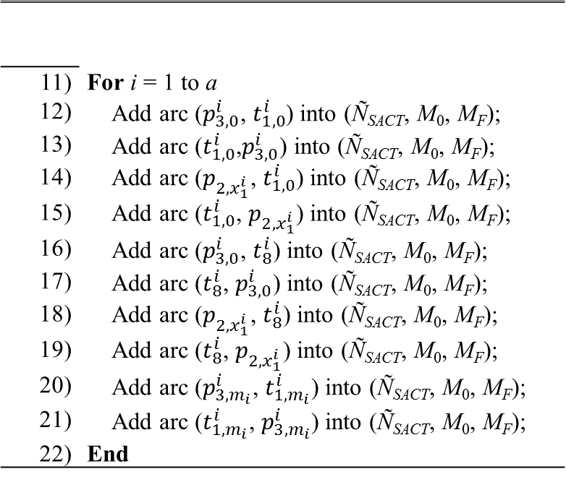
Deadlock analysis
7
Algorithm 2.1: A Petri net model obtained by Definition 2.2 is controlled by self-loops.
Input: | (Ñ_{SACT}, M₀, M_{F});
Output: | (Ñ_{SACT-C}, M₀, M_{F});
1) | For i = 1 to a
2) | For j = 1 to m_{j}−1
3) | Add arc ($p_{3,j}^{i}$, $t_{1,j}^{i}$) into (Ñ_{SACT}, M₀, M_{F});
4) | Add arc ($t_{1,j}^{i}$, $p_{3,j}^{i}$) into (Ñ_{SACT}, M₀, M_{F});
5) | Add arc ($p_{2,x_{j+1}^{i}}$, $t_{1,j}^{i}$) into (Ñ_{SACT}, M₀, M_{F});
6) | Add arc ($t_{1,j}^{i}$, $p_{2,x_{j+1}^{i}}$) into (Ñ_{SACT}, M₀, M_{F});
7) | Add arc ($p_{2,x_{j+1}^{i}}$, $t_{6,j}^{i}$) into (Ñ_{SACT}, M₀, M_{F});
8) | Add arc ($t_{6,j}^{i}$, $p_{2,x_{j+1}^{i}}$) into (Ñ_{SACT}, M₀, M_{F});
9) | End
10) | End
11) | For i = 1 to a
12) | Add arc ($p_{3,0}^{i}$, $t_{1,0}^{i}$) into (Ñ_{SACT}, M₀, M_{F});
13) | Add arc ($t_{1,0}^{i}$,$p_{3,0}^{i}$) into (Ñ_{SACT}, M₀, M_{F});
14) | Add arc ($p_{2,x_{1}^{i}}$, $t_{1,0}^{i}$) into (Ñ_{SACT}, M₀, M_{F});
15) | Add arc ($t_{1,0}^{i}$, $p_{2,x_{1}^{i}}$) into (Ñ_{SACT}, M₀, M_{F});
16) | Add arc ($p_{3,0}^{i}$, $t_{8}^{i}$) into (Ñ_{SACT}, M₀, M_{F});
17) | Add arc ($t_{8}^{i}$, $p_{3,0}^{i}$) into (Ñ_{SACT}, M₀, M_{F});
18) | Add arc ($p_{2,x_{1}^{i}}$, $t_{8}^{i}$) into (Ñ_{SACT}, M₀, M_{F});
19) | Add arc ($t_{8}^{i}$, $p_{2,x_{1}^{i}}$) into (Ñ_{SACT}, M₀, M_{F});
20) | Add arc ($p_{3,m_{i}}^{i}$, $t_{1,m_{i}}^{i}$) into (Ñ_{SACT}, M₀, M_{F});
21) | Add arc ($t_{1,m_{i}}^{i}$, $p_{3,m_{i}}^{i}$) into (Ñ_{SACT}, M₀, M_{F});
22) | End

Slide 18
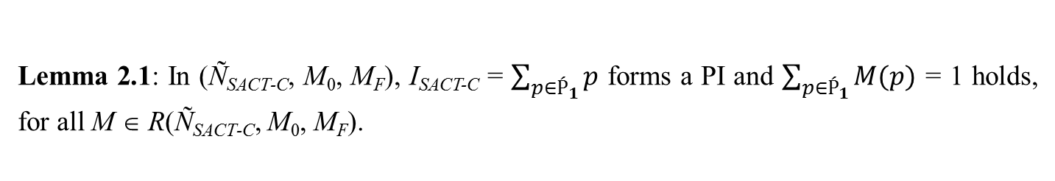
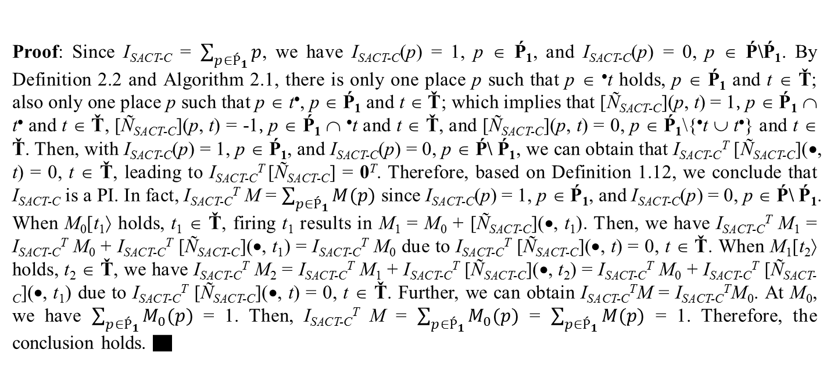
Deadlock analysis
7
Lemma 2.1: In (Ñ_{SACT-C}, M₀, M_{F}), I_{SACT-C} = $\sum_{p{∈Ṕ}_{1}}{p}$ forms a PI and $\sum_{p∈Ṕ_{1}}{M(p)}$ = 1 holds, for all M ∈ R(Ñ_{SACT-C}, M₀, M_{F}).
Proof: Since I_{SACT-C} = $\sum_{p∈Ṕ_{1}}{p}$, we have I_{SACT-C}(p) = 1, p ∈ Ṕ₁, and I_{SACT-C}(p) = 0, p ∈ Ṕ\Ṕ₁. By Definition 2.2 and Algorithm 2.1, there is only one place p such that p ∈ •t holds, p ∈ Ṕ₁ and t ∈ Ť; also only one place p such that p ∈ t•, p ∈ Ṕ₁ and t ∈ Ť; which implies that [Ñ_{SACT-C}](p, t) = 1, p ∈ Ṕ₁ ∩ t• and t ∈ Ť, [Ñ_{SACT-C}](p, t) = -1, p ∈ Ṕ₁ ∩ •t and t ∈ Ť, and [Ñ_{SACT-C}](p, t) = 0, p ∈ Ṕ₁\{•t ∪ t•} and t ∈ Ť. Then, with I_{SACT-C}(p) = 1, p ∈ Ṕ₁, and I_{SACT-C}(p) = 0, p ∈ Ṕ\ Ṕ₁, we can obtain that I_{SACT-C}^{T} [Ñ_{SACT-C}](•, t) = 0, t ∈ Ť, leading to I_{SACT-C}^{T} [Ñ_{SACT-C}] = 0^{T}. Therefore, based on Definition 1.12, we conclude that I_{SACT-C} is a PI. In fact, I_{SACT-C}^{T} M = $\sum_{p∈Ṕ_{1}}{M(p)}$ since I_{SACT-C}(p) = 1, p ∈ Ṕ₁, and I_{SACT-C}(p) = 0, p ∈ Ṕ\ Ṕ₁. When M₀[t₁⟩ holds, t₁ ∈ Ť, firing t₁ results in M₁ = M₀ + [Ñ_{SACT-C}](•, t₁). Then, we have I_{SACT-C}^{T} M₁ = I_{SACT-C}^{T} M₀ + I_{SACT-C}^{T} [Ñ_{SACT-C}](•, t₁) = I_{SACT-C}^{T} M₀ due to I_{SACT-C}^{T} [Ñ_{SACT-C}](•, t) = 0, t ∈ Ť. When M₁[t₂⟩ holds, t₂ ∈ Ť, we have I_{SACT-C}^{T} M₂ = I_{SACT-C}^{T} M₁ + I_{SACT-C}^{T} [Ñ_{SACT-C}](•, t₂) = I_{SACT-C}^{T} M₀ + I_{SACT-C}^{T} [Ñ_{SACT-C}](•, t₁) due to I_{SACT-C}^{T} [Ñ_{SACT-C}](•, t) = 0, t ∈ Ť. Further, we can obtain I_{SACT-C}^{T}M = I_{SACT-C}^{T}M₀. At M₀, we have $\sum_{p{∈Ṕ}_{1}}{M_{0}(p)}$ = 1. Then, I_{SACT-C}^{T} M = $\sum_{p∈Ṕ_{1}}{M_{0}(p)}$ = $\sum_{p∈Ṕ_{1}}{M(p)}$ = 1. Therefore, the conclusion holds. ▇

Slide 19
Deadlock analysis
7
Lemma 2.2: Let M be a marking in R(Ñ_{SACT-C}, M₀, M_{F}) and p ∈ Ṕ₁ be a place. If M(p) = 1, for all t ∈ Ť\p•, t is disabled at M.
Ṕ₁ = {p₁, p₇}∪ {$p_{4,j}^{i}$| i ∈ $ℕ_{a}^{+}$, j ∈ $ℕ_{m_{i}}^{+}$}∪{$p_{5,j(j+1)}^{i}$, $p_{6,j}^{i}$| i ∈ $ℕ_{a}^{+}$, j ∈ $ℕ_{m_{i}}$}∪{$p_{9}^{i}$| i ∈ $ℕ_{a}^{+}$}.
Proof: It is known that, for all M ∈ R(Ñ_{SACT-C}, M₀, M_{F}), M(p) = 1, p ∈ Ṕ₁. Then, based on Lemma 2.1, we have M(p′) = 0, p′ ∈ Ṕ₁\{p}. It follows from Definition 2.2 and Algorithm 3.1 that Ṕ₁ ∩ •t contains only one place, for all t ∈ Ť. Thus, for all t ∈ Ť\p•, Ṕ₁ ∩ •t ∈ Ṕ₁\{p} holds. Therefore, by Definition 1.5, t is disabled, t ∈ Ť\p•, since there exists p′ ∈ Ṕ₁\{p} with M(p′) = 0. ▇

Slide 20
Deadlock analysis
7
Theorem 2.1: For (Ñ_{SACT-C}, M₀, M_{F}) of an SACT with a ≥ 2 wafer types in a lot to be processed, for all M ∈ R(Ñ_{SACT}, M₀, M_{F})\{M_{F}}, there exists a transition t ∈ Ť such that M[t⟩ hold.
Definition 2.3: For (Ñ_{SACT}, M₀, M_{F}) and (Ñ_{SACT-C}, M₀, M_{F}), if there does not exist a marking M, M ∈ R(Ñ_{SACT}, M₀, M_{F})\{M_{F}} and M ∉ R(Ñ_{SACT-C}, M₀, M_{F})\{M_{F}}, such that (Ñ_{SACT}, M₀, M_{F}) can evolve to M_{F} from M, then it is an optimal control method by self-loops obtained by Algorithm 2.1.
Theorem 2.2: For (Ñ_{SACT}, M₀, M_{F}), it is an optimal control method by self-loops obtained by Algorithm 2.1.

Slide 21
System scheduling
8
start
timed PN model
PN-based earliest starting algorithm
enable transition
end
No
Yes
the set of enable transition at marking M_{k}
earliest starting strategy
choose an enable transition (minimal token residual time in its preset)
state transfer equation M_{k} = M_{k-1} + A^{T}*Ƶ_{k}
change the marking
from M_{k} to M_{k}’

Slide 22
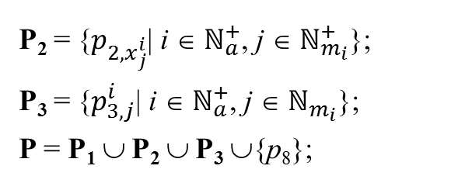
System scheduling
8
M_{k+1} = M_{k} + [N_{SACT-C}]^{T}× Ƶ_{k+1}, k ≥ 0 (2.1)
Ṕ₁ = {p₁, p₇}∪ {$p_{4,j}^{i}$| i ∈ $ℕ_{a}^{+}$, j ∈ $ℕ_{m_{i}}^{+}$}∪{$p_{5,j(j+1)}^{i}$, $p_{6,j}^{i}$| i ∈ $ℕ_{a}^{+}$, j ∈ $ℕ_{m_{i}}$}∪{$p_{9}^{i}$| i ∈ $ℕ_{a}^{+}$};
P₂ = {$p_{2,x_{j}^{i}}$| i ∈ $ℕ_{a}^{+}$, j ∈ $ℕ_{m_{i}}^{+}$};
P₃ = {$p_{3,j}^{i}$| i ∈ $ℕ_{a}^{+}$, j ∈ $ℕ_{m_{i}}$};
P = P₁ ∪ P₂ ∪ P₃ ∪{p₈};
χ_{i}(p) is used to denote the time point when a token enters p ∈ P₃, when M_{i} is reached.
χ_{i}(p) = $\left\{\begin{aligned}_{i}, if M_{i−1}\left(p\right)=0, M_{i}\left(p\right)=1, and i ≥ 1 \\ 0, otherwise \end{aligned}\right.$ (2.2)

Slide 23
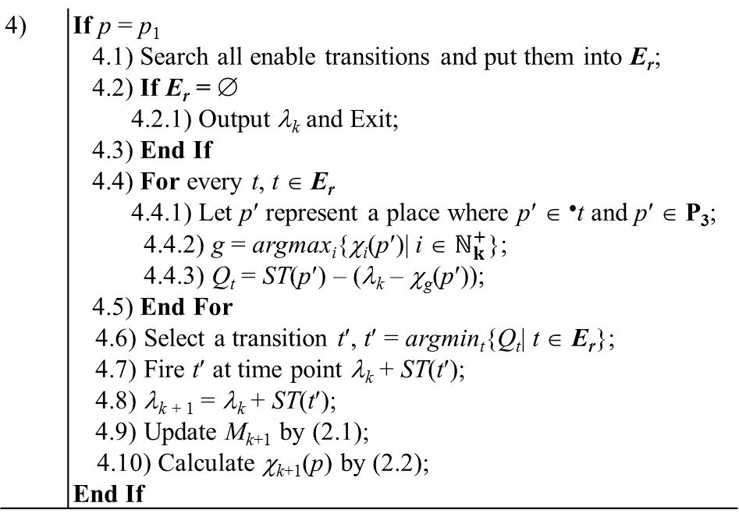
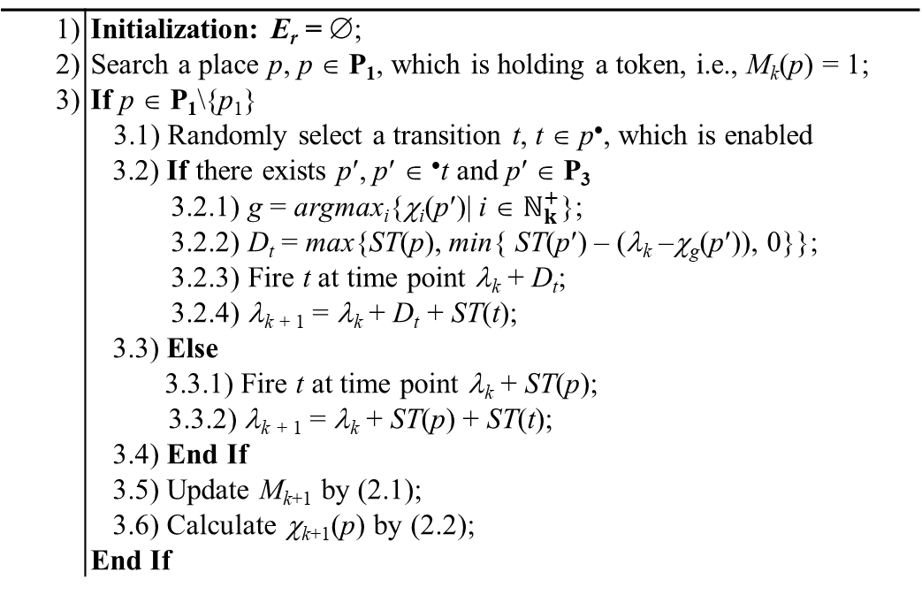
System scheduling
8
1) | Initialization: E_{r} = ∅;
2) | Search a place p, p ∈ P₁, which is holding a token, i.e., M_{k}(p) = 1;
3) | If p ∈ P₁\{p₁}
 | 3.1) Randomly select a transition t, t ∈ p•, which is enabled
 | 3.2) If there exists p′, p′ ∈ •t and p′ ∈ P₃
 | 3.2.1) g = argmax_{i}{χ_{i}(p′)| i ∈ $ℕ_{k}^{+}$};
 | 3.2.2) D_{t} = max{ST(p), min{ ST(p′) – (λ_{k} –χ_{g}(p′)), 0}}; 3.2.3) Fire t at time point λ_{k} + D_{t};
 | 3.2.4) λ_{k} ₊ ₁ = λ_{k} + D_{t} + ST(t);
 | 3.3) Else
 | 3.3.1) Fire t at time point λ_{k} + ST(p);
 | 3.3.2) λ_{k} ₊ ₁ = λ_{k} + ST(p) + ST(t);
 | 3.4) End If
 | 3.5) Update M_{k+1} by (2.1); 3.6) Calculate χ_{k+1}(p) by (2.2); End If
4) | If p = p₁
 | 4.1) Search all enable transitions and put them into E_{r}; 4.2) If E_{r} = ∅ 4.2.1) Output λ_{k} and Exit; 4.3) End If
 | 4.4) For every t, t ∈ E_{r}
 | 4.4.1) Let p′ represent a place where p′ ∈ •t and p′ ∈ P₃;
 | 4.4.2) g = argmax_{i}{χ_{i}(p′)| i ∈ $ℕ_{k}^{+}$};
 | 4.4.3) Q_{t} = ST(p′) – (λ_{k} – χ_{g}(p′));
 | 4.5) End For
 | 4.6) Select a transition t′, t′ = argmin_{t}{Q_{t}| t ∈ E_{r}};
 | 4.7) Fire t′ at time point λ_{k} + ST(t′);
 | 4.8) λ_{k} ₊ ₁ = λ_{k} + ST(t′);
 | 4.9) Update M_{k+1} by (2.1); 4.10) Calculate χ_{k+1}(p) by (2.2);
 | End If
PN-based earliest starting algorithm

Slide 24
Examples
9
Table 2.2 Experimental results
Software: TINA + TCT
 | Study cases | N_{P} | N_{T} | N_{M} | N_{LM} | N_{IM}
(Ñ_{SACT}, M₀, M_{F}) | Example 1 | 30 | 31 | 1506 | 751 | 754
 | Example 2 | 40 | 41 | 10366 | 5007 | 5358
(Ñ_{SACT-C}, M₀, M_{F}) | Example 1 | 30 | 31 | 752 | 751 | 0
 | Example 2 | 40 | 41 | 5008 | 5007 | 0
Example 1:
WFP₁ = (PM₁, PM₂)
WFP₂ = (PM₁, PM₃)
Example 2:
WFP₁ = (PM₁, PM₂)
WFP₂ = (PM₁, PM₃)

Slide 25
Examples
9
Wafer Flow Pattern | NDW | Average Makespan (s) |  | Average CPU Time (s) |  | Cost- cutting
 |  | PN-ESS | SA | PN-ESS | SA | (ten-thous /per month)
WFP₁ = (PM₁, PM₃, PM₄) | (12, 13) | 4371.0 | 4265.5 | 0.3 | 31.6 | 1.2
WFP₂ = (PM₁, PM₂, PM₄) | (6, 19) | 4278.0 | 4204.0 | 0.3 | 36.5 | 0.8
WFP₁ = (PM₁, PM₃) | (17, 8) | 4136.4 | 3710.6 | 0.5 | 46.3 | 5.2
WFP₂ = (PM₂, PM₃, PM₄, PM₅) | (12, 13) | 4256.8 | 3911.8 | 0.8 | 59.1 | 4.1
WFP₁ = (PM₃, PM₂, PM₄) | (12, 13) | 4868.4 | 4722.0 | 0.4 | 47.4 | 1.5
WFP₂ = (PM₁, PM₃, PM₅) | (7, 18) | 4934.0 | 4802.0 | 0.4 | 43.3 | 1.3
WFP₁ = (PM₁, PM₃, PM₄) | (12, 5, 8) | 3660.0 | 3151.0 | 0.6 | 68.6 | 7.0
WFP₂ = (PM₁, PM₃, PM₅) | (4, 15, 6) | 3068.0 | 2710.9 | 0.4 | 70.0 | 5.8
WFP₃ = (PM₂, PM₅, PM₆) | (6, 10, 9) | 2926.4 | 2488.1 | 0.4 | 47.6 | 7.5
WFP₁ = (PM₁, PM₃, PM₄) | (1, 1, 1, 1) | 460.7 | 405.0 | 0.3 | 43.0 | 6.1
WFP₂ = (PM₁, PM₅) | (3, 3, 3, 3) | 1133.8 | 990.4 | 0.3 | 58.4 | 6.3
WFP₃ = (PM₂, PM₄) | (6, 2, 7, 10) | 2873.2 | 2690.2 | 0.3 | 59.4 | 3.2
WFP₄ = (PM₃, PM₅, PM₆) | (2, 10, 4, 9) | 3010.4 | 2344.8 | 0.4 | 47.2 | 11.1

Slide 26
Thanks！

